Slide 1

Presidential Advisory Commission on Election Integrity
Hans von Spakovsky
Manager, Election Law Reform Initiative and Senior Legal Fellow,
Meese Center for Legal and Judicial Studies, The Heritage Foundation

Slide 2

The right to vote in a free and fair election is the most basic civil right, one on which many other rights of the American people depend.
Congress and the states should guarantee that every eligible individual is able to vote and that no one’s vote is stolen or diluted.
Election fraud is real and hundreds of convictions have been made and documented, and there are problems with the accuracy of voter rolls throughout the nation.

Slide 3
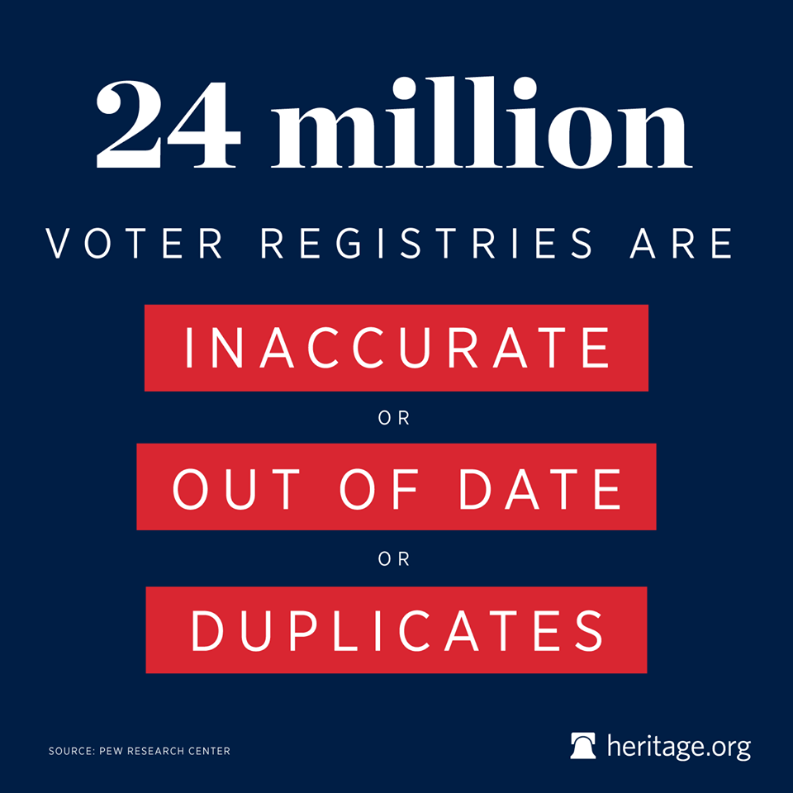
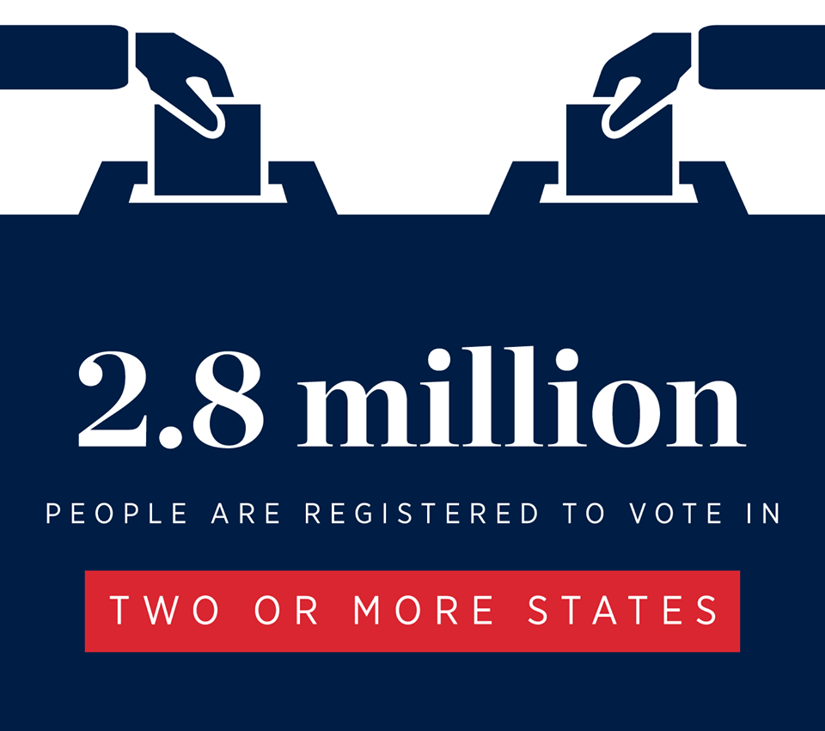
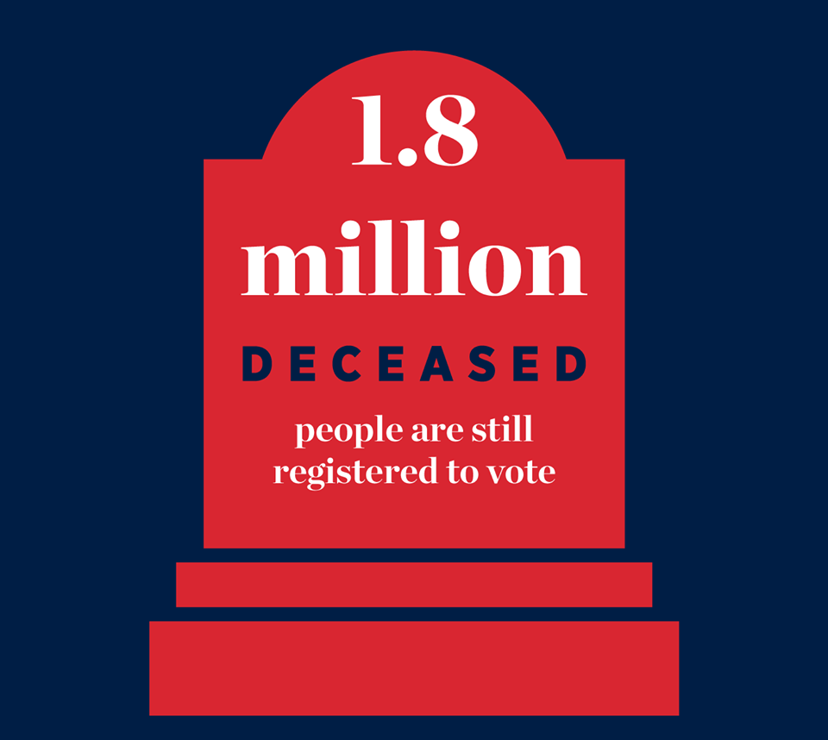
Pew Center for the States
2012 Study

Slide 4
Voter Registration Rate as % of Citizen Voting Age Population
2016 Election Administration & Voting Survey
Report of U.S. Election Assistance Commission
Alaska- 112.13%
California- 100.85%
Colorado- 102.38%
DC- 101.68%
Indiana- 100.79%
Kentucky- 100.27%
Maine- 101.61%
Michigan- 101.81%

Slide 5
Heritage Election Fraud Database
heritage.org/voterfraud
Search county, state & federal court records; contact state Attorneys General and Secretaries of State offices; investigate local newspaper reports.
Heritage Voter Fraud Database documents 1,071 proven incidents of election fraud ranging from one illegal vote to hundreds, and resulting in the disenfranchisement of thousands of lawful voters.
    938 Criminal Convictions
    43 Civil Penalties
    74 Diversion Programs
    8 Judicial Findings
    8 Official Findings

Slide 6
Heritage Election Fraud Database
heritage.org/voterfraud
Examples of some of the cases in the database that illustrate the many different ways fraud is committed are in the following slides.
The database is not a comprehensive listing because of the difficulty of obtaining information on unreported cases; there is no central source for information on election fraud; we continue to add cases every day as we find them.
There are many potential cases of election fraud that are not prosecuted and are thus not in the database; the Public Interest Legal Foundation, for example, recently released a report on 5,556 noncitizens removed from voter rolls in Virginia, after casting 7,474 ballots. No information on these voters was sent to law enforcement for investigation and possible prosecution despite the fact that it is a felony for a noncitizen to register or vote. See “Alien Invasion II,” Public Interest Legal Foundation (May 2017).
Similarly, a 2005 GAO report found that up to 3 percent of the 30,000 individuals called for jury duty from voter registration rolls over a two-year period in one federal district court were not U.S. citizens. Yet election officials were apparently not notified and the U.S. Justice Department did not investigate these individuals to determine if they had violated the federal law banning noncitizens from registering. See Gov't Accountability Office, Elections: Additional Data Could Help State and Local Election Officials Maintain Accurate Voter Registration Lists 42 (2005).

Slide 7
False Registrations
Voting under fraudulent voter registrations that either use a phony name and a real or fake address or claim residence in a particular jurisdiction where the registered voter does not actually live and is not entitled to vote.
Location: California
Year: 2000
Edward Barquet and Michelle Corrall
GOP voter registration employees during the 2000 general election
Sought to capitalize on a $4 bounty for each Republican voter successfully registered.
Submitted multiple fraudulent registrations, which included false information and forged signatures.
Pleaded guilty; each sentenced to serve four months in jail and a $220 fine, followed by five years’ probation.
Location: Washington
Year: 2008
ACORN
Worst registration fraud in state history
1,762 illegal forms.
The leader, Clifton Mitchell, received three months in jail.
Four other ACORN workers on Mitchell’s team also sent to jail.
ACORN fined $25,000.

Slide 8
Impersonation Fraud at the Polls
Voting in the name of other legitimate voters and voters who have died, moved away, or lost their right to vote because they are felons, but remain registered.
Location: Alabama
Year: 2002
Shasta Nicole Crayton
Illegally voted in her sister’s name.
Was discovered after her sister later tried to vote.
Two year prison sentence reduced to time served plus two years’ probation.
Location: Texas
Year: 2009
Lorenzo Antonio Almanza
Convicted of voting twice in a local school board election- once as himself and once as his incarcerated brother.
Received two years’ imprisonment and five years’ probation.

Slide 9
Duplicate Voting
Registering in multiple locations and voting in the same election in more than one jurisdiction or state.
Location: Wisconsin
Year: 2011-2012
Robert Monroe
Worst multiple voter in WI history- voted multiple times in five elections from 2011-2012.
Including five times in Gov. Walker’s recall.
Received a suspended three year prison sentence, 300 hours’ community service, and a $5,000 fine.
Location: Maryland
Year: 2006 & 2010
Wendy Rosen, 2012 Democrat candidate for Maryland’s 1st U.S. Congressional District
Voted in both Florida and Maryland in 2006 & 2010 elections
Pleaded guilty and was sentenced to five years’ probation, a $5,000 fine, and 500 hours of community service.
When the fraud came to light, she was forced to withdraw from the race.

Slide 10
Absentee Ballot Fraud
Requesting absentee ballots and voting without the knowledge of the actual voter; or obtaining the absentee ballot from a voter and either filling it in directly and forging the voter’s signature or illegally telling the voter who to vote for.
Location: Kentucky
Year: 2014
Mayor Ruth Robinson and co-conspirators
Targeted residents in public housing and in Robinson-owned properties.
Threatened to evict them if they did not sign pre-filled absentee ballots.
Also targeted the elderly/offered to buy votes.
Received 90 months’ imprisonment.
Location: Alabama
Year: 1994
Eleven Greene County residents
Including county commissioners and a city councilman.
Used an assembly line to mass produce absentee ballots.
Nine pleaded guilty and the other two were convicted.

Slide 11
Illegal Assistance at the Polls
Forcing or intimidating voters—particularly the elderly, disabled, illiterate, and those for whom English is a second language—to vote for particular candidates while supposedly providing them with “assistance.”
Location: Texas
Year: 2016
Guadalupe Rivera, former Weslaco city commissioner
Illegally assisted a voter by filling out an absentee ballot in a way the voter did not want.
Rivera won his re-election bid by 16 votes.
A judge ordered a new election, which Rivera lost, after determining there were 30 illegal ballots cast.
Sentenced to one year of probation and fined.
Location: Texas
Year: 2006
Maria Dora Flores
Pleaded guilty to illegal assistance after escorting several voters to their polling place and filling out and submitting their ballots without their consent.
Received two years’ probation and fined.

Slide 12
Buying Votes
Paying voters to cast either an in-person or absentee ballot for a particular candidate.
Location: West Virginia
Year: 1990-2004
Six individuals pleaded guilty
Engaged in vote buying conspiracies in every election from 1990-2004.
Distributed lists with preferred candidates.
Used liquor, $20 cash payments, and fixing of traffic tickets to buy votes.
Location: Illinois
Year: 2004
Precinct Committeemen Charles Powell, Sheila Thomas, Jesse Lewis, and Kelvin Ellis and Precinct Worker Yvette Johnson
Convicted for conspiracy to commit election fraud
Used city funds to buy votes.

Slide 13
Non-citizen Voting
Illegal registration and voting by individuals who are not U.S. citizens.
Location: Illinois
Year: 2006
Margarita Del Pilar Fitzpatrick falsely claimed to be a U.S. citizen when filling out her Motor Voter application.
Illegally voted in the 2006 election.
Her fraud was not discovered by election officials; it was only detected when she applied for naturalization and her case was investigated by the Department of Homeland Security.
Year: 2006
Anthony Kimani falsely claimed to be a U.S. citizen when filling out his Motor Voter application.
Illegally voted in the 2004 election.
His fraud was not discovered by election officials; it was only discovered when he applied for permanent residency and his case was investigated by DHS.
Location: Alabama
Year: 1996-2008
Venustiano Hernandez-Hernandez, an illegal alien, registered to vote under the false identity of Severo Benavidez
Obtained a false birth certificate, which he used to collect Social Security disability benefits and register to vote.
Voted in elections under the false identity between 1996-2008
Received approximately $80,000 in disability payments between 2008 and 2012.

Slide 14
Felon Voting
Illegal registration and voting by individuals who are convicted felons.
Location: Ohio
Year: 2016
Jessica Steinke
She was convicted in 2014 for bail jumping.
Pleaded no contest to charges that she voted in the 2016 election despite being a convicted felon.
Sentenced to 80 hours of community service, 18 months of probation, and ordered to attend counseling.
Location: Florida
Year: 2012
Onakia Lanet Griffin
Previously convicted of wire fraud, identification theft, and identity fraud.
Registered and voted in the 2012 election.
Sentenced to a fine of $1079.50 and 23 days’ incarceration.

Slide 15
Altering the Vote Count
Changing the actual vote count either in a precinct or at the central location where votes are counted.
Location: California
Year: 2007 & 2009
Angel Perales & Mayor David Silva
Widespread corruption scheme in Cudahy, CA
Included accepting cash bribes, abusing drugs at City Hall, and throwing out absentee ballots that favored election challengers.
FBI Investigation revealed they tampered with mail-in ballots in city elections by opening them and then resealing and submitting votes for incumbent candidates while discarding votes for challengers.
Both pleaded guilty to bribery and extortion charges.
Location: Oregon
Year: 2012
Deanna Swenson, Clackamas County elections official
Tampered with ballots by filling in blank spots left by the actual voters.
Pleaded guilty to official misconduct and unlawfully altering a ballot.
Sentenced to 90 days in jail and $13,000 in fines.

Slide 16
Ballot Petition Fraud
Forging the signatures of registered voters on the ballot petitions that must be filed with election officials in some states for a candidate or issue to be listed on the official ballot.
Location: Indiana
Year: 2008
Butch Morgan, Jr.
Former Democratic Chairman for St. Joseph County
Worked with co-conspirators from the Board of Voter Registration to forge over 200 signatures.
Goal of getting Barack Obama and Hillary Clinton on the 2008 Indiana Democratic Primary ballot.
Sentenced to one year in prison.
Location: Michigan
Year: 2012
Brandon Hall
Hired by Ottawa County District Court Candidate Chris Houghtaling to acquire the necessary signatures for his candidacy.
Houghtaling reportedly did not care whether the signatures were collected legally or illegally, and even assisted in Hall’s crime by providing him old 2010 petitions to copy.
Hall also used a phone book to complete the ballot petition
Convicted of ten counts of ballot petition fraud.

Slide 17
The Impact of Election Fraud
The National Commission on Federal Election Reform has stated, the problem “is not the magnitude of voter fraud. In close or disputed elections, and there are many, a small amount of fraud could make the margin of difference.” The U.S. Supreme Court has concurred with this assessment, noting that known instances of fraud “demonstrate that not only is the risk of voter fraud real but that it could affect the outcome of a close election.” See Crawford v. Marion County, 553 U.S. 181 (2008)
→ In 2015, a city council election in the New Jersey town of Perth Amboy was decided by a mere 10 votes. A judge overturned the election and ordered a new one after it was revealed that at least 13 illegal absentee ballots had been cast.
→ In 2003, a mayoral primary in East Chicago, Indiana, was overturned by the state Supreme Court after evidence of widespread fraud was revealed. The new election resulted in a different winner.
In 2010, the aunt and uncle of John Joseph Rizzo, a candidate for the 40th legislative district in Missouri, falsely registered so they could vote for their nephew. He won the primary race by one vote.

Slide 18
Interstate Crosscheck Program
In recent years, proactive secretaries of state across the country have taken the lead in securing American elections. Kansas and Missouri initiated the Interstate Voter Registration Crosscheck Program on a bipartisan basis to compare state lists and ensure accurate and current voter registration rolls are maintained. It identifies hundreds of thousands of potentially duplicate registrations, as well as evidence of double voting. There are now 30 states participating.
Location: Kansas
Year: 2016
James Criswell
Cast ballots in both Colorado and Kansas in the 2016 election.
Pleaded no contest to the charge of double voting and was fined $1,000 and ordered to pay $158 in court costs.
Detected through the Interstate Crosscheck Program.
Location: Kansas
Year: 2010, 2013, and 2014
Lincoln Wilson
Voted in both Kansas and Colorado in elections in 2010, 2012, and 2014.
Pleaded guilty and was ordered to pay a $6,000 fine.
Detected through the Interstate Crosscheck Program.

Slide 19
2016 Interstate Crosscheck Comparison
The voter registration list comparison in 2016 of the states participating in the Crosscheck Program, similar to the 2012 Pew study, showed hundreds of thousands of potentially duplicate registrations in multiple states. What is unknown is what steps states took to correct this problem or to check voter histories to find voters who voted illegally in multiple states:
STATE – Voters Registered in Other States
Alabama – 220,247
Arizona – 240,277
Arkansas – 110,200
Colorado – 257,413
Georgia – 540,245
Idaho – 20,834
Illinois – 454,325
Indiana – 452,577
Iowa – 129,925
Kansas – 123,502
Kentucky – 311,126
Louisiana – 119,207
STATE – Voters Registered in Other States
Massachusetts – 144,587
Michigan – 406,268
Mississippi – 162,288
Missouri – 244,710
Nebraska – 60,766
Nevada – 85,968
New York – 392,365
North Carolina – 455,891
Ohio – 386,092
Oklahoma – 89,788
South Dakota – 34,367
Tennessee – 218,641
Virginia – 284,618

Slide 20
2013 Presidential Commission on Election Administration
The 2013 Commission appointed by President Barack Obama found that accurate voter registration lists were essential to the proper management of elections and improving the voting experience. It found that the lack of quality voter lists directly impacted the ability of people to vote and even reduced the ability of political parties and election officials to monitor elections to detect problems, fraud, and other irregularities.
A key area of inquiry for the Commission should be an examination of the extent to which states are using available databases and other information to verify the accuracy of their voter registration lists – and how often they are doing so. That includes:
State departments of motor vehicles and corrections records
State and county tax and vital statistics records
Federal and state jury declination information
Commercial databases and services such as Google Earth
Federal records such as the Systematic Alien Verification for Entitlements database, Social Security Administration death records, and the Federal Bureau of Prisons conviction records
The National Change of Address system maintained by the U.S. Postal Service.

Slide 21
Voter Intimidation
The correct legal term for “voter suppression” is actually voter intimidation. Section 11b of the Voting Rights Act of 1965 (52 U.S.C. §10307) make it unlawful for anyone to “intimidate, threaten, or coerce, or attempt to intimidate, threaten, or coerce any person for voting or attempting to vote.”
According to the website of the Voting Section of the Civil Rights Division of the U.S. Department of Justice, which is charged with enforcing 11b, only two cases have been filed under this provision:
United States v. New Black Panther Party (E.D. Pa. 2009) - On January 7, 2009, DOJ filed a complaint against the New Black Panther Party in the Eastern District of Pennsylvania over violations of Section 11(b) of the Voting Rights Act, including intimidation of voters and those aiding voters.
United States v. Ike Brown and Noxubee County, MS (S.D. Miss. 2005) – In 2007, a federal district court entered a remedial order after finding a wide range of discriminatory and illegal voting practices in violation of the Voting Rights Act.
U

Slide 22
Overseas Military and Civilian Voters
The Uniformed and Overseas Citizen Absentee Voting Act guarantees the rights of military personnel and their families and civilians who are located overseas to vote by absentee ballot in our elections. Unfortunately, the disenfranchisement rate of overseas Americans is very high.
In its 2016 report, the U.S. Election Assistance Commission found that only 68.1 percent of requested UOCAVA ballots were returned to election officials.
Of the completed UOCAVA ballots rejected by election officials, 44.4 percent were not counted because they were received after the applicable deadline. This illustrates the problems that Americans stationed in remote areas of the world have in voting due to the long delays in mail service.
This is an important issue that the Commission should investigate to determine if there are any changes that can be made to improve the ability of American abroad to participate in our elections.

